Slide 1
VOLUME CONTROL USING HAND GESTURES
By:
Vasu Gupta – 2101903
Simran Khanna – 2101869
Vansh Thakkar - 2101897

Slide 2
Introduction
Gesture recognition helps computers to understand human body language. This helps to build a more potent link between humans and machines, rather than just the basic text user interfaces or graphical user interfaces (GUIs). In this project for gesture recognition, the human body’s motions are read by computer camera. Thecomputer then makes use of this data as input to handle applications. The objective of this project is to develop an interface which will capture human hand gesture dynamically and will control the volume level.

Slide 3
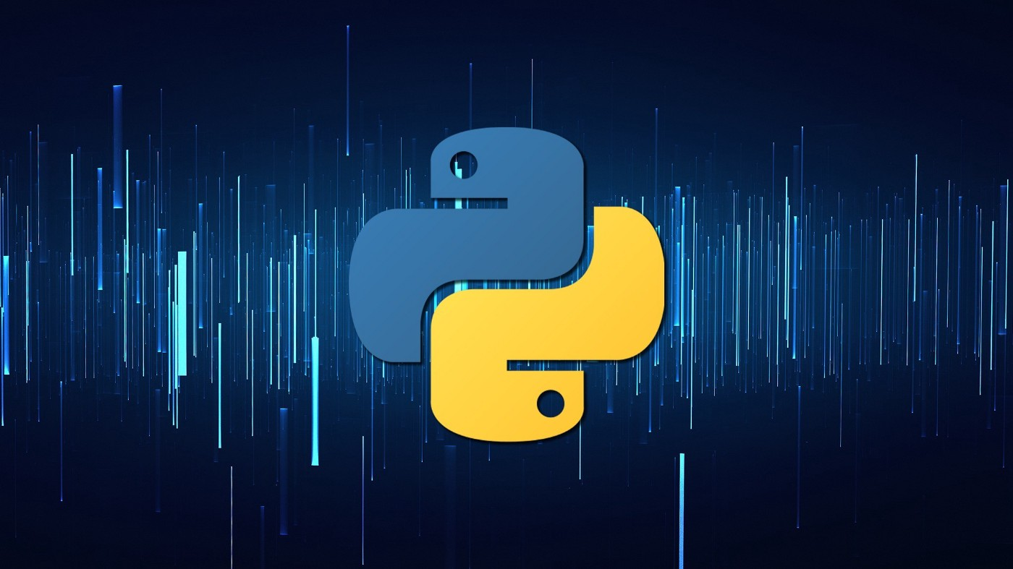
TECHNOLOGY USED:
Python is an interpreted, object-oriented, high-level programming language with dynamic semantics. Its high-level built-in data structures, combined with dynamic typing and dynamic binding, make it very attractive for Rapid Application Development, as well as for use as a scripting or glue language to connect existing components together.

Slide 4
Libraries Used:
Numpy
Pycaw
Mediapipe
NumPy is a library for the Python programming language, adding support for large, multi-dimensional arrays and matrices, along with a large collection of high-level mathematical functions to operate on these arrays
Python Audio Control Library
Mediapipe is an open-source machine learning library of Google, which has some solutions for face recognition and gesture recognition, and provides encapsulation of python, js and other languages.

Slide 5
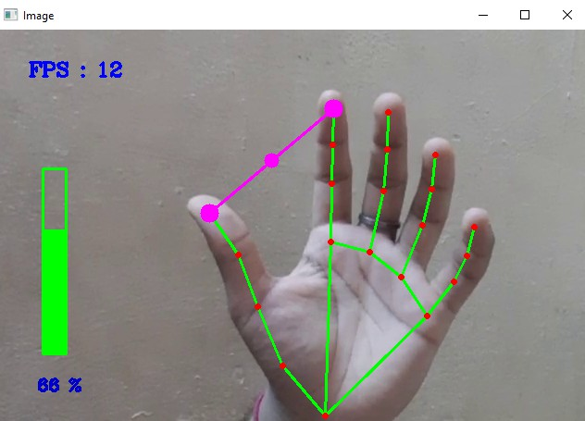
WORKING PRINCIPLE
The camera in our device is used for this project. It detects our hand with points in it so as it can see the distance between our thumb finger tip and index finger tip. The distance between the points 4 and 8 is directly proportional to the volume of device.

Slide 6
PRONS: 1. Easy to use 2. Hassle free 3. Fun to use 4. More interactive CONS: 1. Cant be used for long distance 2. Sometimes not accurate 3. Requires a decent camera 4. May be confused by two palms

Slide 7
Thank you

